Slide 1
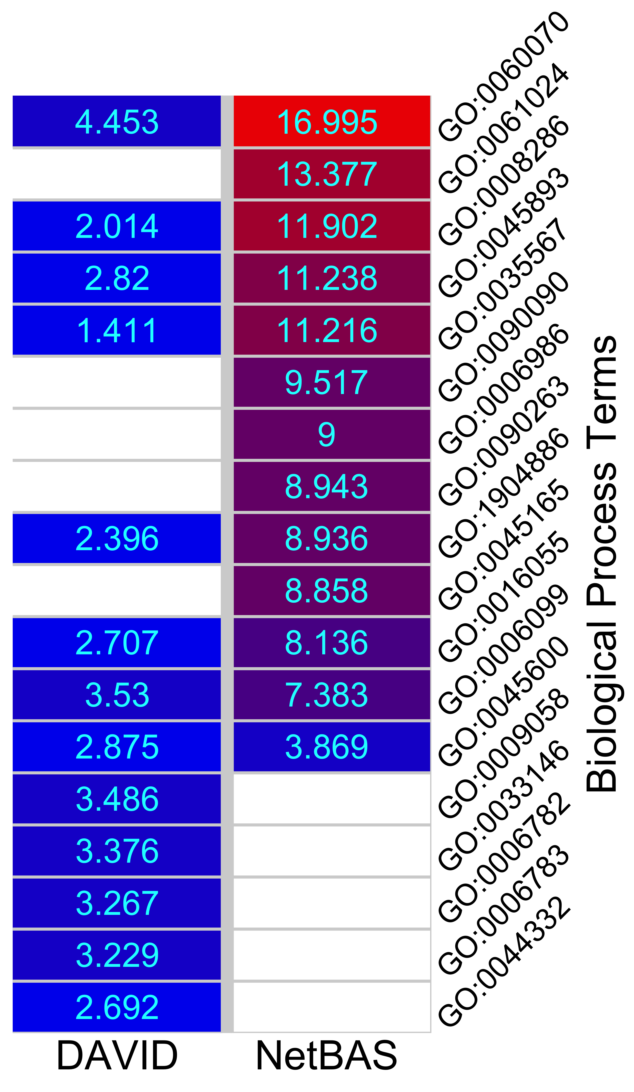
Top 10 enriched BP terms, DAVID vs NetBAS
# | DAVID |  | NetBAS
1 | GO:0060070 | canonical Wnt signaling pathway (p=4.2e-6, z=4.5) | GO:0060070 | canonical Wnt signaling pathway (z=17.0)
2 | GO:0006099 | tricarboxylic acid cycle (p=2.1e-4, z=3.5) | GO:0061024 | membrane organization (z=13.4)
3 | GO:0009058 | biosynthetic process (p=2.5e-4, z=3.5) | GO:0008286 | insulin receptor signaling pathway (z=11.9)
4 | GO:0033146 | regulation of intracellular estrogen receptor signaling pathway (p=3.7e-4, z=3.4) | GO:0035567 | non-canonical Wnt signaling pathway (z=11.2)
5 | GO:0006782 | protoporphyrinogen IX biosynthetic process (p=5.4e-4, z=3.3) | GO:0090090 | negative regulation of canonical Wnt signaling pathway (z=9.5)
6 | GO:0006783 | heme biosynthetic process (p=6.2e-4, z=3.2) | GO:0006986 | response to unfolded protein (z=9.0)
7 | GO:0045600 | positive regulation of fat cell differentiation (p=0.0020, z=2.9) | GO:0090263 | positive regulation of canonical Wnt signaling pathway (z=8.9)
8 | GO:0045893 | positive regulation of transcription, DNA-templated (p=0.0024, z=2.8) | GO:1904886 | beta-catenin destruction complex disassembly (z=8.9)
9 | GO:0016055 | Wnt signaling pathway (p=0.0034, z=2.7) | GO:0045165 | cell fate commitment (z=8.9)
10 | GO:0044332 | Wnt signaling pathway involved in dorsal/ventral axis specification (p=0.0035, z=2.7) | GO:0016241 | regulation of macroautophagy (z=8.6)

Slide 2
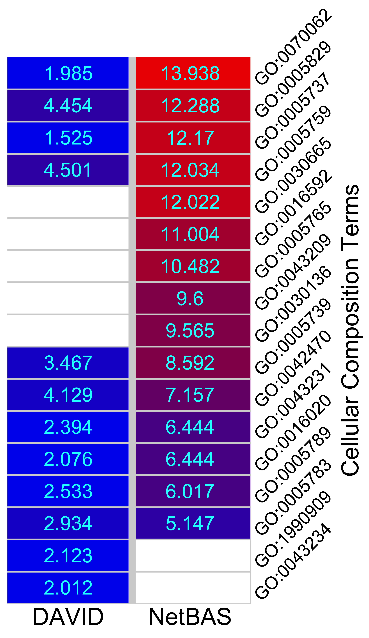
Top 10 enriched CC terms, DAVID vs NetBAS
# | DAVID |  | NetBAS
1 | GO:0005759 | mitochondrial matrix (p=3.4e-6, z=4.5) | GO:0070062 | extracellular exosome (z=14.0)
2 | GO:0005829 | cytosol (p=4.2e-6, z=4.5) | GO:0005829 | cytosol (z=12.3)
3 | GO:0042470 | melanosome (p=1.8e-5, z=4.1) | GO:0005759 | mitochondrial matrix (z=12.0)
4 | GO:0005739 | mitochondrion (p=2.6e-4, z=3.5) | GO:0030665 | clathrin-coated vesicle membrane (z=12.0)
5 | GO:0005783 | endoplasmic reticulum (p=0.0017, z=2.9) | GO:0005765 | lysosomal membrane (z=10.5)
6 | GO:0005789 | endoplasmic reticulum membrane (p=0.0057, z=2.5) | GO:0043209 | myelin sheath (z=9.6)
7 | GO:0043231 | intracellular membrane-bounded organelle (p=0.0083) | GO:0030136 | clathrin-coated vesicle (z=9.6)
8 | GO:1990909 | Wnt signalosome (p=0.017, z=2.1) | GO:0005739 | mitochondrion (z=8.6)
9 | GO:0016020 | membrane (p=0.019, z=2.1) | GO:0032991 | protein-containing complex (z=7.4)
10 | GO:0043234 | protein complex (0.022, z=2.0) | GO:0042470 | melanosome (z=7.157)

Slide 3
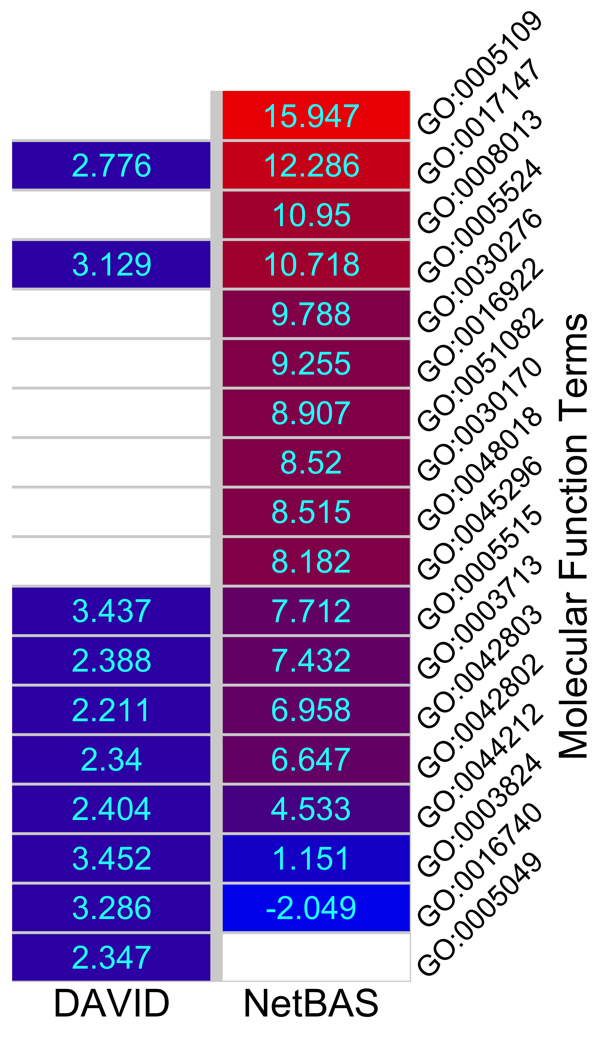
Top 10 enriched MF terms, DAVID vs NetBAS
# | DAVID |  | NetBAS
1 | GO:0003824 | catalytic activity (p=2.8e-4, z=3.5) | GO:0005109 | frizzled binding (z=15.9)
2 | GO:0005515 | protein binding (p=2.9e-4, z=3.4) | GO:0017147 | Wnt-protein binding (z=12.3)
3 | GO:0016740 | transferase activity (p=5.1e-4, z=3.3) | GO:0008013 | beta-catenin binding (z=11.0)
4 | GO:0005524 | ATP binding (p=8.8e-4, z=3.1) | GO:0005524 | ATP binding (z=10.7)
5 | GO:0017147 | Wnt-protein binding (p=0.0028, z=2.8) | GO:0030276 | clathrin binding (z=9.8)
6 | GO:0044212 | transcription regulatory region DNA binding (p=0.0081, z=2.4) | GO:0016922 | nuclear receptor binding (z=9.3)
7 | GO:0003713 | transcription coactivator activity (p=0.0085, z=2.4) | GO:0051082 | unfolded protein binding (z=8.9)
8 | GO:0005049 | nuclear export signal receptor activity (p=0.0095, z=2.3) | GO:0030170 | pyridoxal phosphate binding (z=8.5)
9 | GO:0042802 | identical protein binding (p=0.0096, z=2.3) | GO:0048018 | receptor ligand activity (z=8.5)
10 | GO:0042803 | protein homodimerization activity (p=0.014, z=2.2) | GO:0045296 | cadherin binding (z=8.2)

